Slide 1
Estimation of business type in Toronto city locations
Sandya Rani Nelakurti

Slide 2
Introduction
Business loss due to wrong location
Technologies using for business
Foursquare API
Investors or business persons interest

Slide 3

Data acquisition and cleaning
The locations from the Toronto can be found in the following link
https://en.wikipedia.org/wiki/List_of_postal_codes_of_Canada:_M
Scraping the data from the website
Pre-processing the data before sending data to Foursquare API.

Slide 4
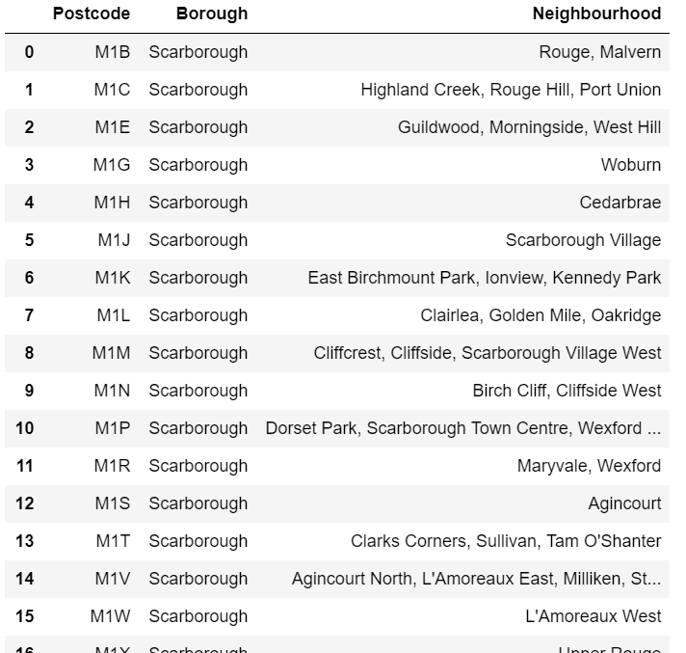
Methodology
Data after cleaning
Features selection

Slide 5
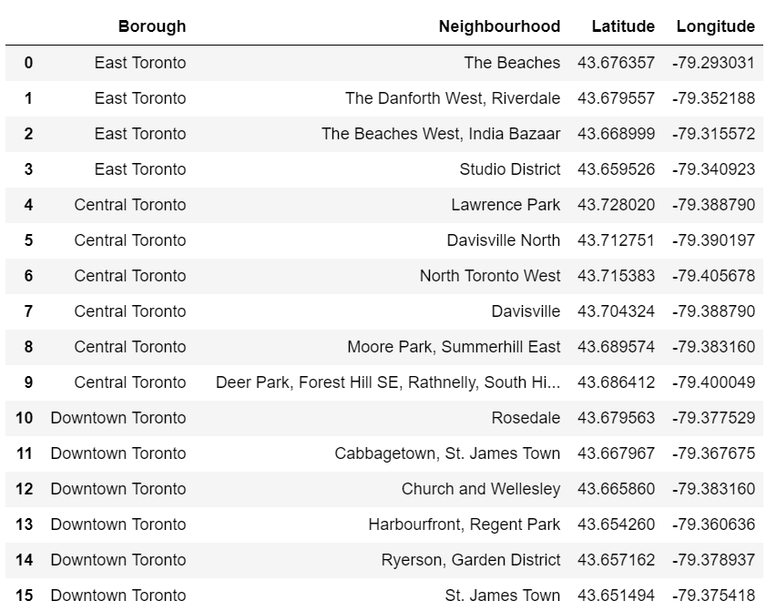
Methodology
Geolocator purpose
Toronto city locations data along with Latitude and Longitude

Slide 6
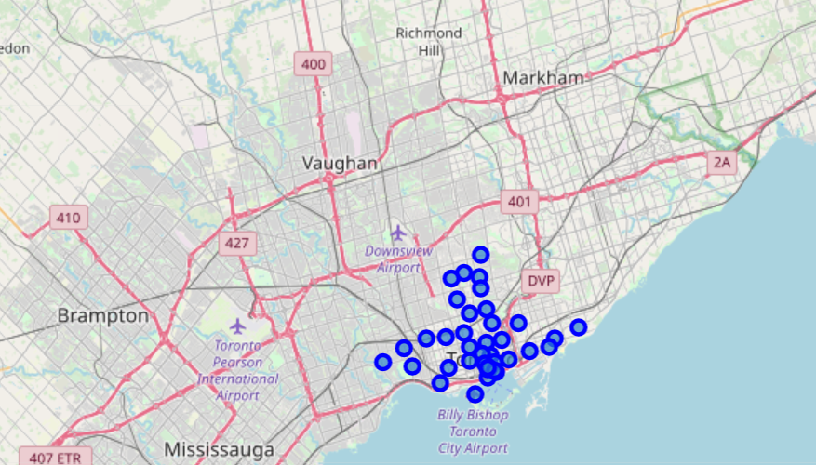
Methodology
Folium introduction
Toronto city postcode map

Slide 7
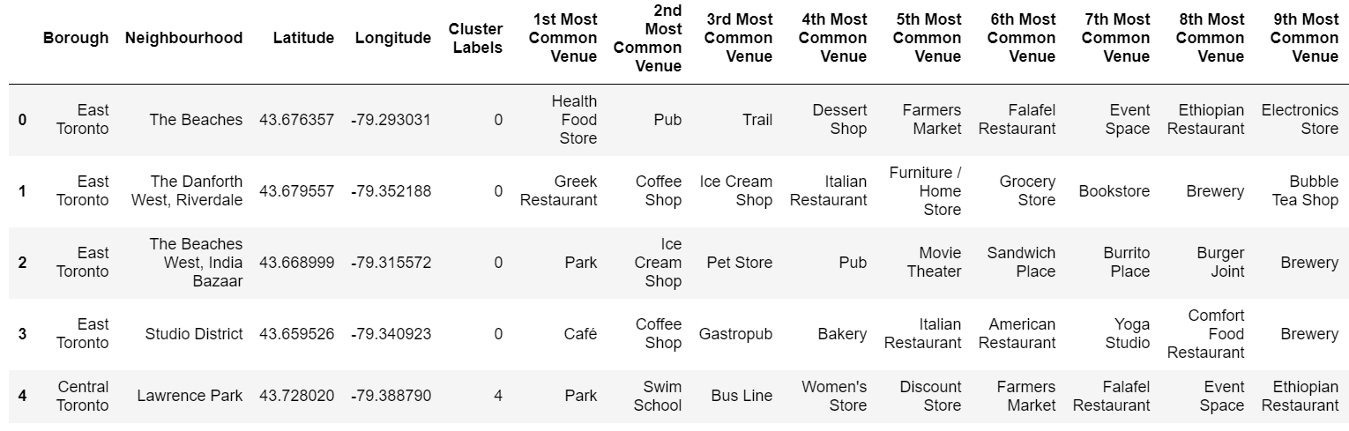
Methodology
One hot coding
K means algorithm
Labelling clusters

Slide 8
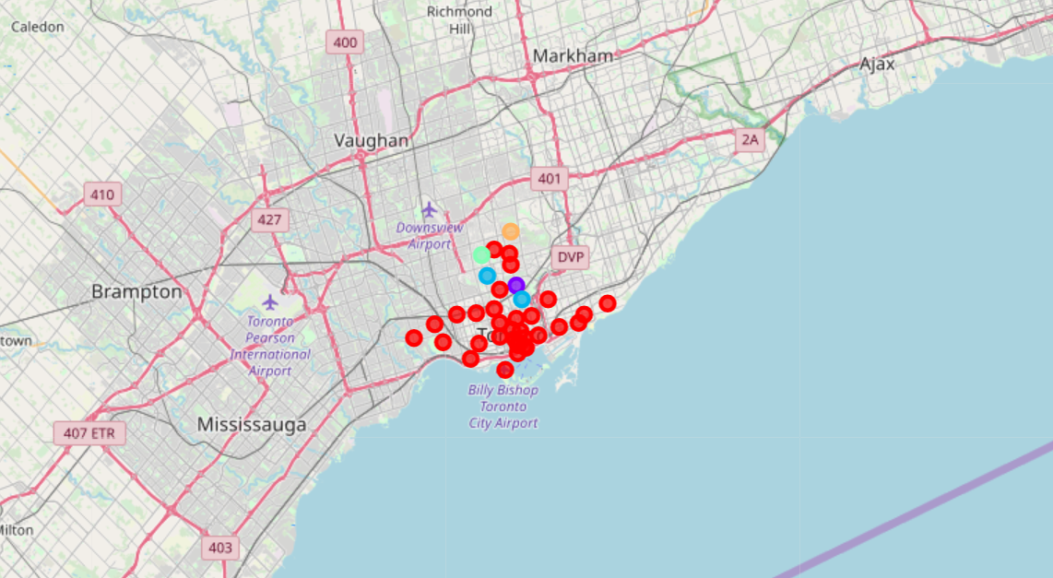
Methodology
Map after clustering

Slide 9
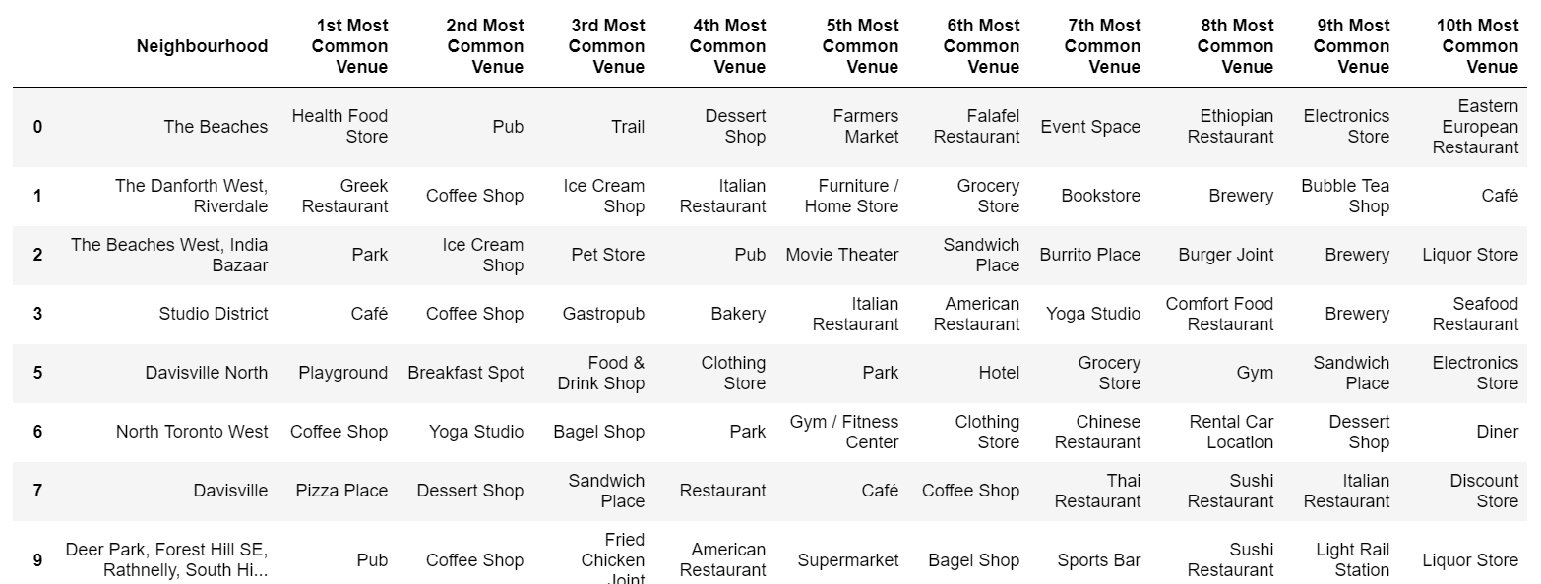
Results
Cluster 0 data

Slide 10
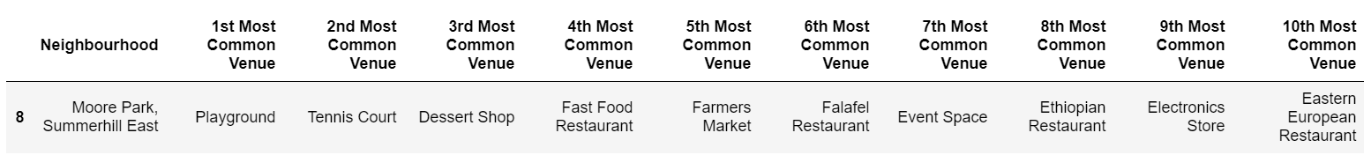
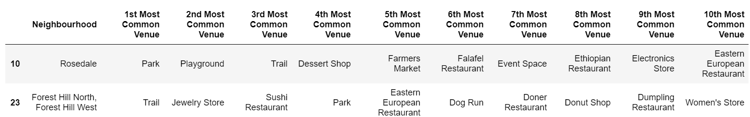
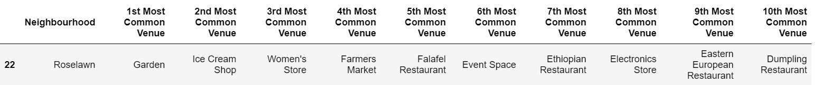
Results
Cluster 1,2,3 data

Slide 11
Discussion/Conclusions
More data give better perspective
Try other algorithms
Examining the results and provide the conclusions
For example:cluster 0 has more café shops and restaurants. Stores supplying ingredients for food making and coffee making may become successful.

Slide 12
References
Toronto Data
Four square API
Python libraries

